Slide 1
Do engineers need mathematics?
Morten Brøns
DTU Compute
mobr@dtu.dk

Slide 2
Merger 2013
Notes:
Copenhagen University College of Engineering

Slide 3
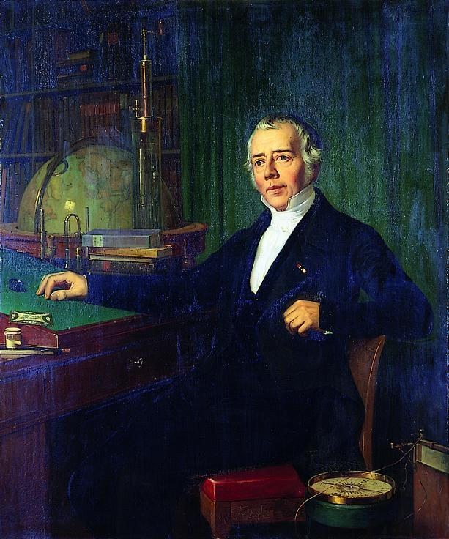
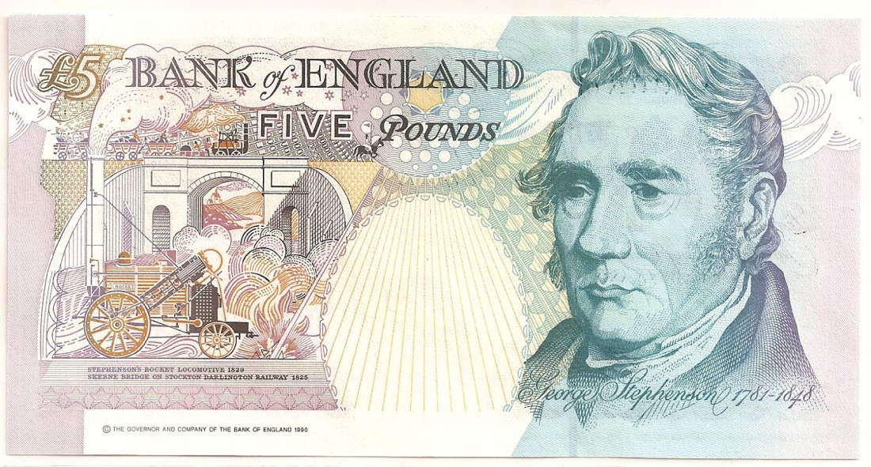
Two philosophies of engineering education and practice
The engineer as a scientist
The engineer as a skilled craftsman

Slide 4
The history of the B.Eng. educations
1881: IHK Founded as Day School for Builders and Machine Builders educating Teknikumingeniører
1957: Danish Engineering Academy (DIA) formed on the DTU campus, providing a 4-year education as Akademiingeniør
1993: The degrees Teknikumingeniør and Akademiingeniør harmonized to Diplomingeniør (B.Eng.) – 3½ years including ½ year internship
1995: DIA merges with DTU
2013: IHK merges with DTU

Slide 5
Mathematics for B.Eng. at DTU before the fusion
Two 5 ECTS courses common for all study lines
DiploMat 1: Complex numbers, polynomials, Taylor’s formula, first and second order differential equations, partial derivatives
DiploMat 2: Systems of linear equations, matrices, eigenvalues and -vectors, systems of linear differential equations, extrema for functions of several variables
One or two projects on a problem emerging from engineering
Use Maple for projects and as a dynamic answer book ”compute by hand – check with Maple”
Weekly lectures and excercise sessions with a TA. Written exam

Slide 6
Teaching philosophy
Mathematics is a tool and a way of thinking which pervades all engineering disciplines.
To make best use of mathematics in engineering it is crucial to understand its general and abstract nature
Proofs are given only if they illuminate the use of the theory
Engineering applications concentrated in projects – allows a common course for all study lines

Slide 7
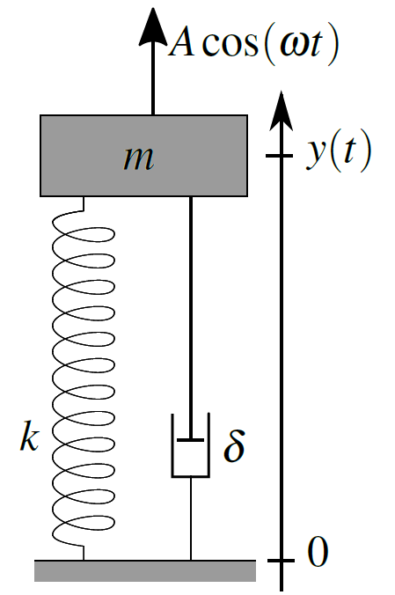
Project example
Wind-induced oscillations of a bridge
How to choose the material constants to avoid the brigde falling down for realistic wind speeds?

Slide 8
Another point of view
“Engineering students basically are not interested in math for math – they are interested in mathematical applications, and most maths can be treated as black boxes, which gives a predefined output for a given input. Somebody has to determine the mechanics inside the black box, but the user don’t have to know this in detail – or too prove it is true, as long as the user knows the limits of allowable inputs and how to evaluate the output. Engineers are used to this kind of work.”
Quote from ”Math for Engineers”, draft working paper, Hans Peter Christensen, 2015(?)
Notes:
Two issues here – maths is not that important, and students are not interested in it.

Slide 9
Merging attempt #1
The mathematical demands for all study lines can’t be covered by common 10 ECTS courses
New course BasisMat essential identical to Diplomat 1 covering topics of interest for all study lines
New idea: ModulMat – short sequences of math to be taught in applied courses when needed.

Slide 10
The modules
Systems of linear equations and matrix algebra (4 weeks)
Determinant, eigenvalues, eigenvectors (3 weeks)
Functions of several variables, Taylor polynomials in several variables, Hesse matrix (2 weeks)
Planar integrals, rectangular and polar coordinates (2 weeks)
Systems of differential equations (2 weeks)
Fourier transform (2 weeks)
Laplace transform (2 weeks)
Logic: predicate logic, quantors, induction (6 weeks)
Difference equations and Z-transform (3 weeks)
Singular value decomposition of 2x2 and 3x3 matrices (3 weeks)
Infinite series, Fourier series (3 weeks)
Curves and curvature (3 weeks)

Slide 11
Practicalities
Each study line must choose modules of total extent 13 weeks, corresponding to 5 ECTS
The modules can be implemented at the discretion of the study leader
The course evaluation must also evaluate the math modules, and they must appear in the learning goals
Optional teaching material provided by DTU Compute for each module

Slide 12
How did it go?
Electrical and Mechanical Engineering: We need so much mathematics that we want a course in linear algebra and Fourier series
The Dean: Single line of responsibility – only the study leaders are responsible for implementation of the modules, not DTU Compute
Very few modules were actually implemented

Slide 13
So what?
The module concept was dumped and a new course in linear algebra with applications (BasisMat 2) is now compulsory for all study lines
9 weeks of basic linear algebra, 3 weeks specialization
Track A: Extrema for functions of two variables, over-determined systems of linear equations
Track B: Systems of differential equations with periodic input, transfer functions
Same structure as BasisMat 1 – lectures, exercises, projects

Slide 14
Merging attempt #2
For the study line Civil Engineering and Infrastructure a special version of BasisMat 1 combining calculus and mechanical physics was tested in 2017
Four cases of
Modelling a physical problem with differential equations
Learning the mathematics needed to solve the equations
Solving the physical problem

Slide 15
The four cases
A body falling through through liquid concrete
(First order DE)
Vibrations of a table, heavily damped or undamped
(Second order homogeneous DE with exponential or harmonic solutions)
Lightly damped wind turbine tower
(Complex numbers, general solution to second order homogeneous DE)
Wind turbine tower with external load
(Second order inhomogeneous DE)

Slide 16
How did that go? Student response
Physics too difficult and demanding too much work
The teaching styles in math and physics are too different
Q: The course mixes maths and physics. Is that motivating for your work?
Very motivating | Somewhat motivating | Doesn’t matter | Not motivating
4% | 48% | 28% | 20%

Slide 17
What would I do differently?
Let mathematics support engineering topics that are central to the study programme
… but I wouldn’t do it again. 16 B.Eng. study lines implies 16 different courses

Slide 18
Challenges for our B.Eng. students
Approx. 50% of the students have the grade 4 (D) or less in mathematics from high school
Definition of the grade 4:
For a fair performance displaying some command of the relevant material but also some major weaknesses

Slide 19
Select incompetences

Slide 20
How to teach complex numbers?
BasisMat 1: Start the course with complex numbers.
Pro: Opportunity to refresh basic algebra in a new context
Experimental course: On-demand when needed to solve differential equations
Pro: Strong motivation

Slide 21
Conclusions
Mathematics-driven courses with connection to engineering through projects is a robust structure
Student motivation seems not to be a problem
How to assess if the teaching actually works?

